Slide 1
An Introduction to Time Series and Demand Forecasting
Presented by
Skander Hannachi

Slide 2
Session Outline
What is Forecasting?
Time Series Forecasting.
An overview of popular forecasting methods:
  Basic methods (naive forecast, simple moving average)
  Some useful concepts: seasonality, trend, etc ...
  Exponential smoothing models
  ARIMA models
  Bayesian forecasting
  Other/Advanced models: Neural Nets, GAM, Hidden Markov models
Useful software packages and tools
Further reading
How we do demand forecasting for merchandising purposes:
  What is special about demand forecasting?
  An overview of the methods we use at Nordstrom:
  Exponential smoothing
  Bayesian forecasting
  Source level forecasting vs. Final level forecasting
  Automatic model selection
Notes:
Lesson descriptions should be brief.

Slide 3
What is forecasting?
Predicting vs. forecasting ?
Forecasting: Predictors are in the past, dependent variable(s) is in the future.
Good predictors are hard to come by.
Time series forecasting: the only available predictors are the past values of the dependent variable.
Notes:
Example objectives
At the end of this lesson, you will be able to:
Save files to the team Web server.
Move files to different locations on the team Web server.
Share files on the team Web server.

Slide 4
Time series forecasting 101
Monday | Tuesday | Wednesday | Thursday | Friday | Saturday | Sunday
1 | 3 | 1 | 3 | 1 | ? | ?
Monday | Tuesday | Wednesday | Thursday | Friday | Saturday | Sunday
1.1 | 1.85 | 3.04 | 4.15 | 4.9 | ? | ?
Notes:
Example objectives
At the end of this lesson, you will be able to:
Save files to the team Web server.
Move files to different locations on the team Web server.
Share files on the team Web server.

Slide 5
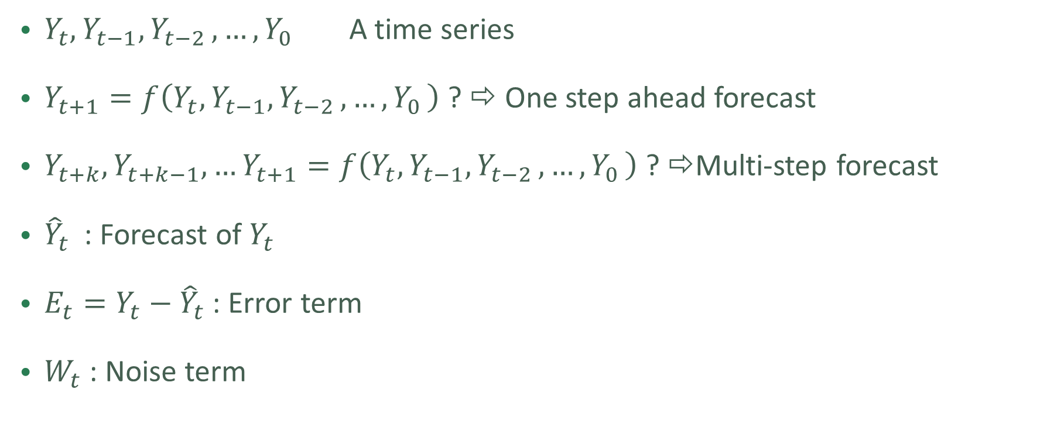
What is forecasting?
$Y_{t},Y_{t−1}{,Y}_{t−2},…{,Y}_{0}$ A time series
$Y_{t+1}=f\left(Y_{t},Y_{t−1}{,Y}_{t−2},…{,Y}_{0}\right)$ ? ⇨ One step ahead forecast
$Y_{t+k},Y_{t+k−1},…Y_{t+1}=f\left(Y_{t},Y_{t−1}{,Y}_{t−2},…{,Y}_{0}\right)$ ? ⇨Multi-step forecast
${\hat{Y}}_{t}$ : Forecast of $Y_{t}$
$E_{t}=Y_{t}−{\hat{Y}}_{t}$ : Error term
$W_{t}$ : Noise term
Notes:
Example objectives
At the end of this lesson, you will be able to:
Save files to the team Web server.
Move files to different locations on the team Web server.
Share files on the team Web server.

Slide 6
Training vs. Test split for time series

Slide 7
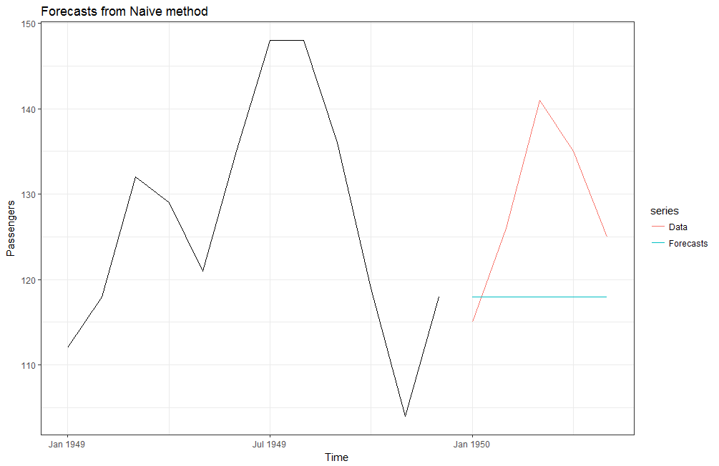

Naïve forecast.
Your best guest for the future is the present:
$${\hat{Y}}_{t+1}=Y_{t}$$
Random Walk:
      $Y_{t+1}=Y_{t}+W_{t}$

Slide 8
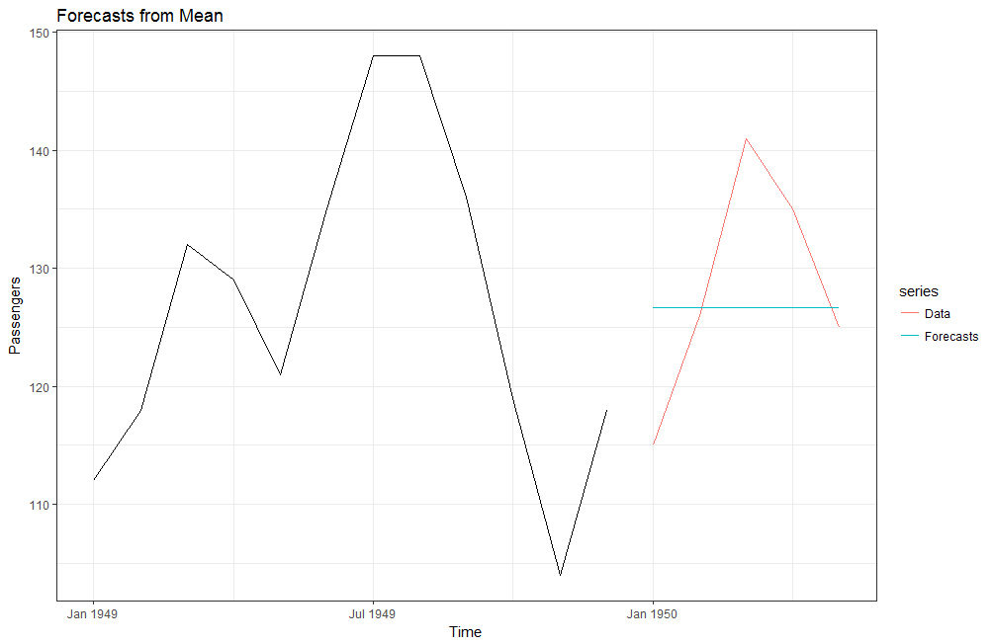

Average / moving average forecast.
Your best guess is the mean of the series:
${\hat{Y}}_{t+1}=mean\left(Y_{t},Y_{t−1}{,Y}_{t−2},…{,Y}_{0}\right)$
$${\hat{Y}}_{t+1}=mean\left(Y_{t},Y_{t−1}{,Y}_{t−2},…{,Y}_{t−n}\right)$$

Slide 9
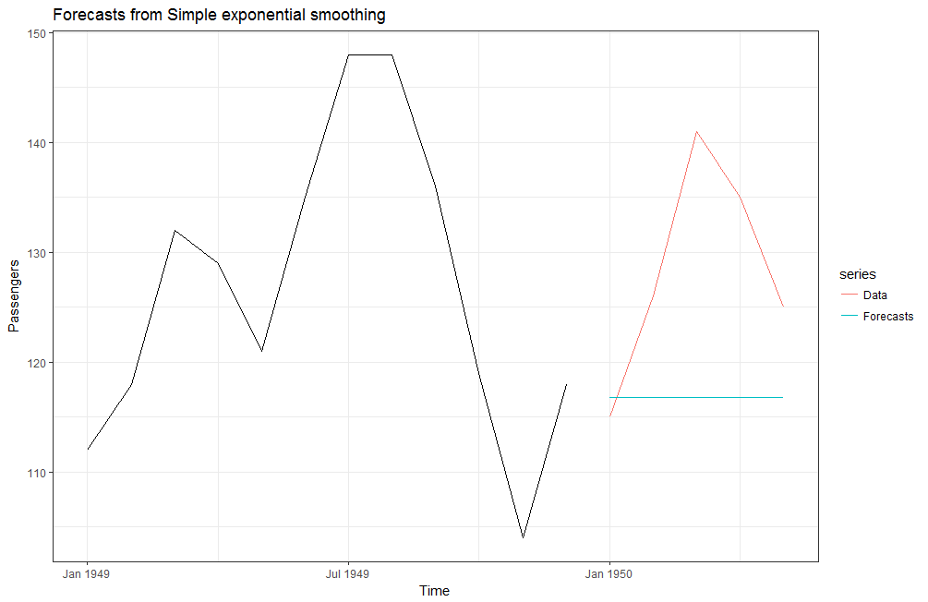
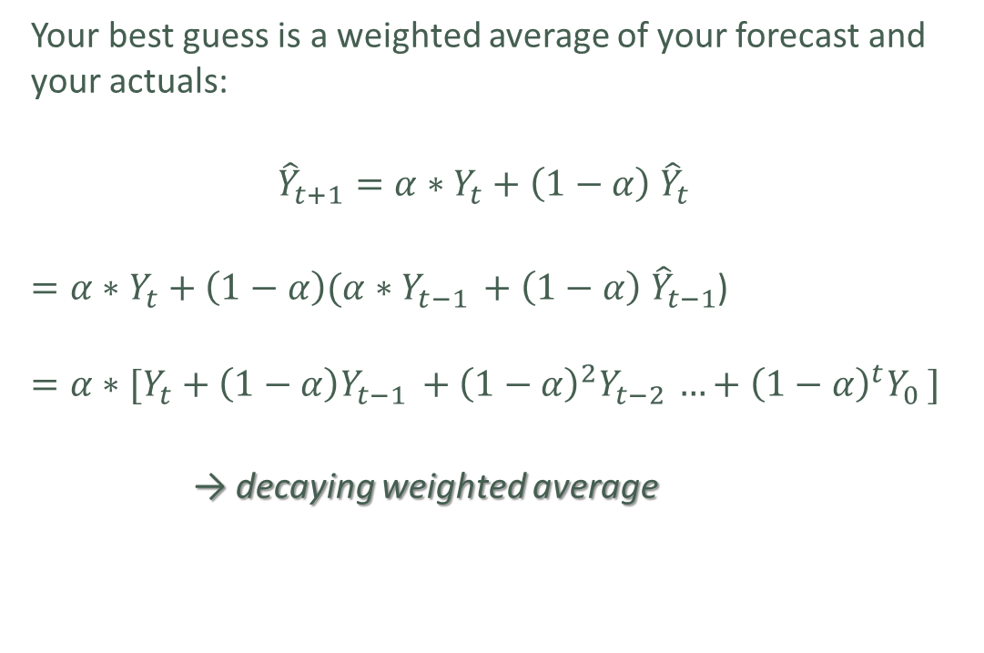
Simple exponential smoothing
Your best guess is a weighted average of your forecast and your actuals:
$${\hat{Y}}_{t+1}=α∗Y_{t}+\left(1−α\right) {\hat{Y}}_{t}$$
$=α∗Y_{t}+\left(1−α\right)(α∗Y_{t−1 }+\left(1−α\right) {\hat{Y}}_{t−1}$)
$$=α∗[Y_{t}+\left(1−α\right)Y_{t−1 }+{\left(1−α\right)}^{2}Y_{t−2 }…+{\left(1−α\right)}^{t}Y_{0 }]$$
→ decaying weighted average

Slide 10
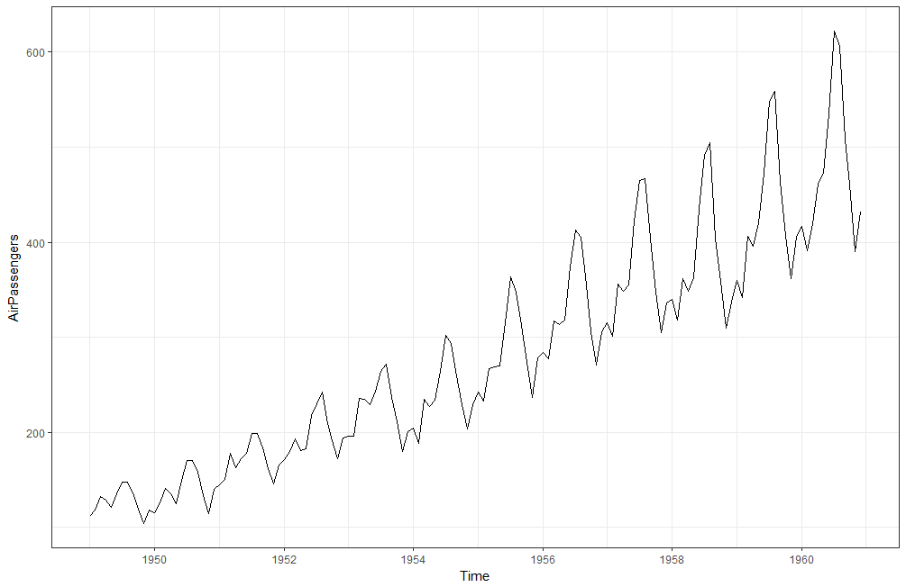
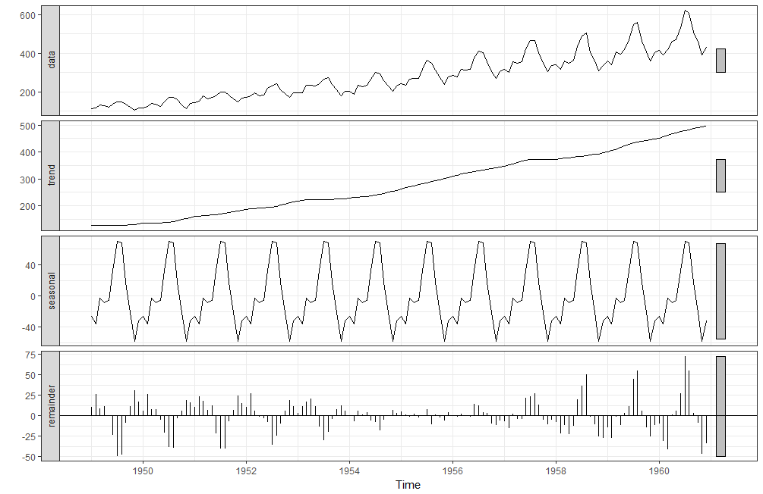
Interlude:
Trend, Seasonality, Residuals

Slide 11
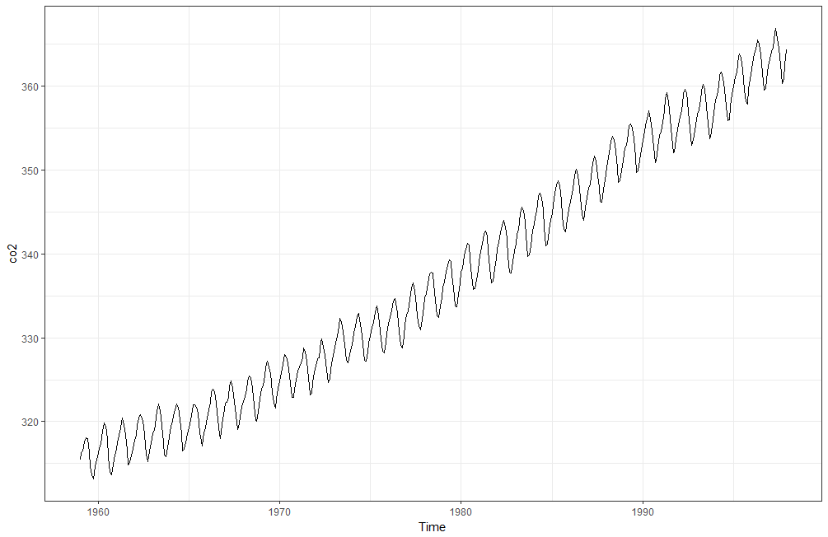
Interlude:
Seasonality: Additive vs. Multiplicative

Slide 12
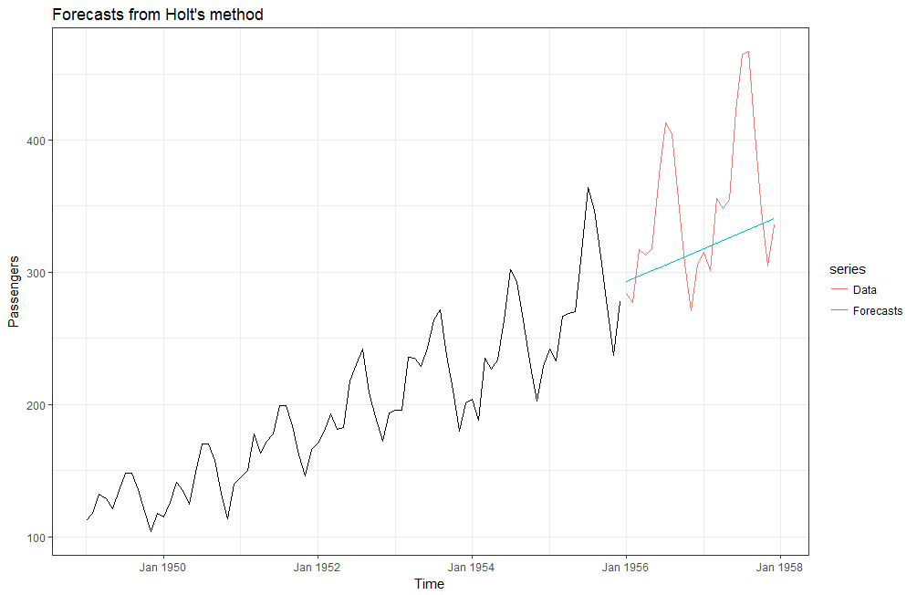
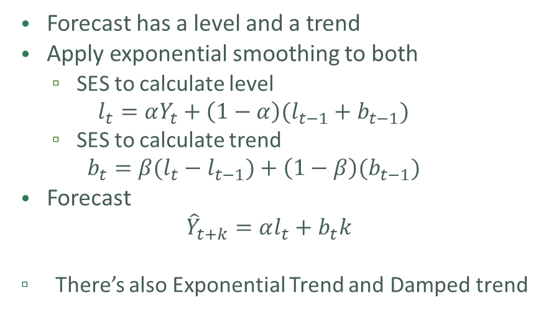
Double exponential smoothing
Holt’s method – linear trend
Forecast has a level and a trend
Apply exponential smoothing to both
  SES to calculate level
  $$l_{t}=αY_{t}+\left(1−α\right)(l_{t−1}+b_{t−1})$$
  SES to calculate trend
  $$b_{t}=β(l_{t}−l_{t−1})+\left(1−β\right)(b_{t−1})$$
Forecast
  $${\hat{Y}}_{t+k}=αl_{t}+b_{t}k$$
  There’s also Exponential Trend and Damped trend

Slide 13
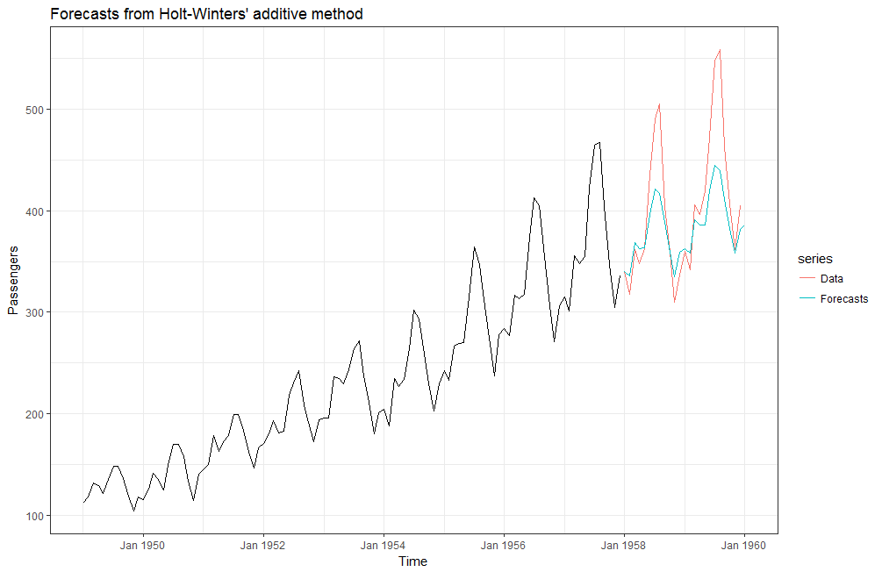
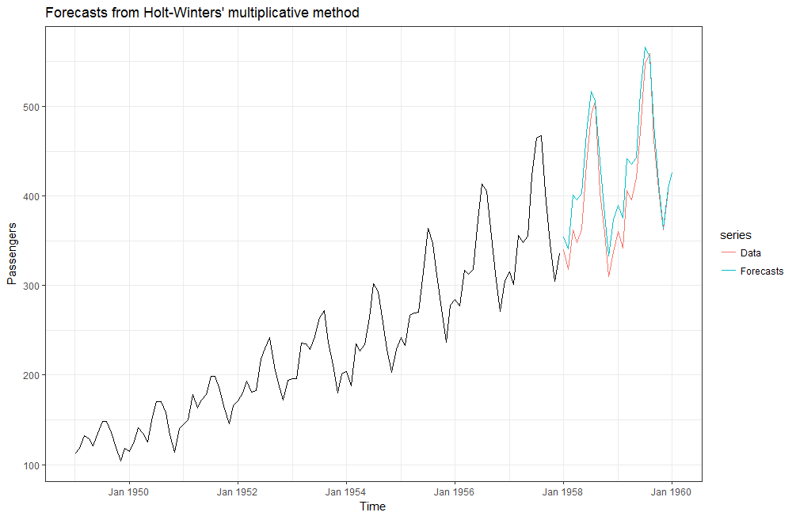
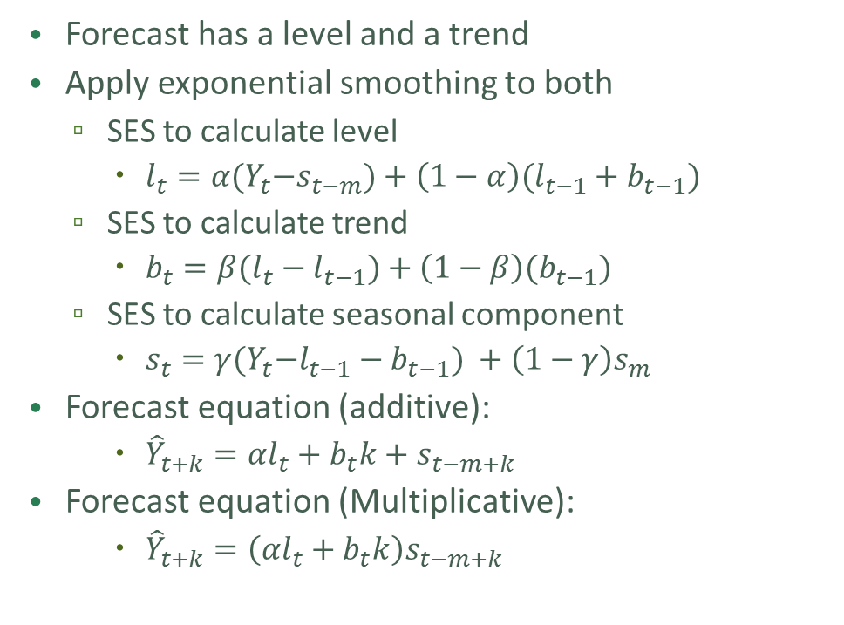
Triple exponential smoothing
Holt-Winters method
Forecast has a level and a trend
Apply exponential smoothing to both
  SES to calculate level
    $l_{t}=α{(Y}_{t}−s_{t−m})+\left(1−α\right)(l_{t−1}+b_{t−1})$
  SES to calculate trend
    $b_{t}=β(l_{t}−l_{t−1})+\left(1−β\right)(b_{t−1})$
  SES to calculate seasonal component
    $s_{t}=γ{(Y}_{t}−l_{t−1}−b_{t−1}) +\left(1−γ\right)s_{m}$
Forecast equation (additive):
    ${\hat{Y}}_{t+k}=αl_{t}+b_{t}k+s_{t−m+k}$
Forecast equation (Multiplicative):
    ${\hat{Y}}_{t+k}=\left(αl_{t}+b_{t}k\right)s_{t−m+k}$

Slide 14
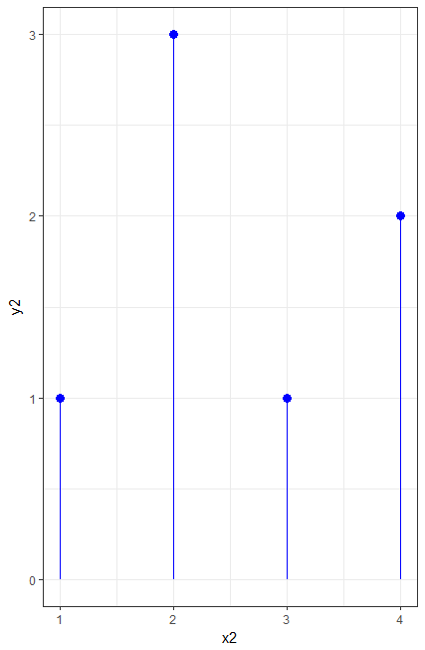
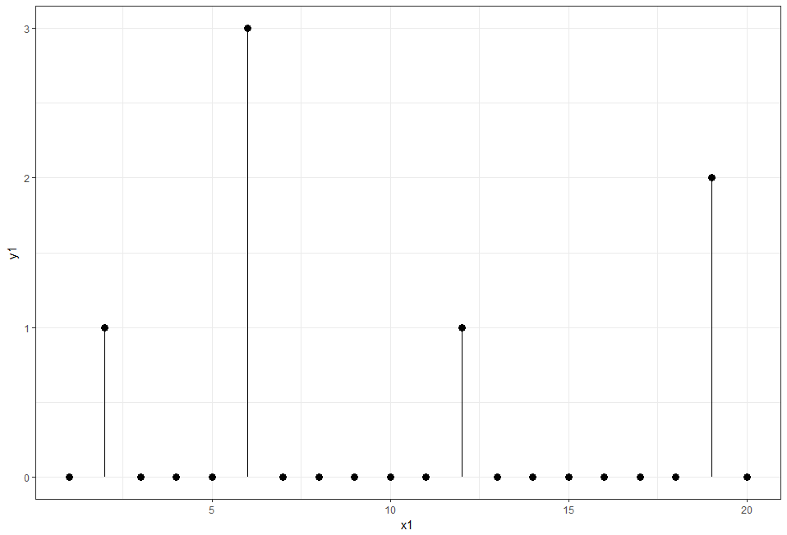
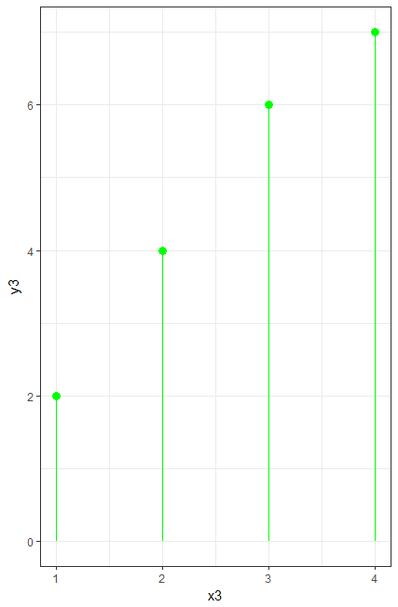


Croston’s method
Intermittent/Sparse data .
Simple Exponential Smoothing:
${\hat{Y}}_{p+1}=α∗Y_{p}+\left(1−α\right) {\hat{Y}}_{p}$
${\hat{I}}_{p+1}=α∗I_{p}+\left(1−α\right) {\hat{I}}_{p}$
Forecast is ratio of values:
${\hat{Y}}_{t+1}=\frac{{\hat{Y}}_{p+1}}{{\hat{I}}_{p+1}}$

Slide 15
ARIMA
Auto-Rregressive Integrated Moving Average
Box & Jenkins 1970.

Slide 16

Auto-Regressive models:
AR(p) : Good Old fashion regression – almost
$Y_{t}=a_{1}Y_{t−1}+a_{2}Y_{t−2 }…+a_{p}Y_{t−p}+W_{t}$
Use regression to calculate $a_{1},a_{2},…a_{p}$

Slide 17

Moving Average:
MA(q):
$Y_{t}=μ+E_{t}+θ_{1}E_{t−1}+θ_{2}E_{t−2}+…θ_{q}E_{t−q}{+W}_{t}$
Use maximum likelyhood to calculate $θ_{1},θ_{2},…θ_{q}$

Slide 18

ARMA models
ARMA(p,q) :
$Y_{t}=a_{1}Y_{t−1}+a_{2}Y_{t−2 }…+a_{p}Y_{t−p}+$
$$μ+E_{t}+θ_{1}E_{t−1}+θ_{2}E_{t−2}+…θ_{q}E_{t−q}{+W}_{t}$$

Slide 19
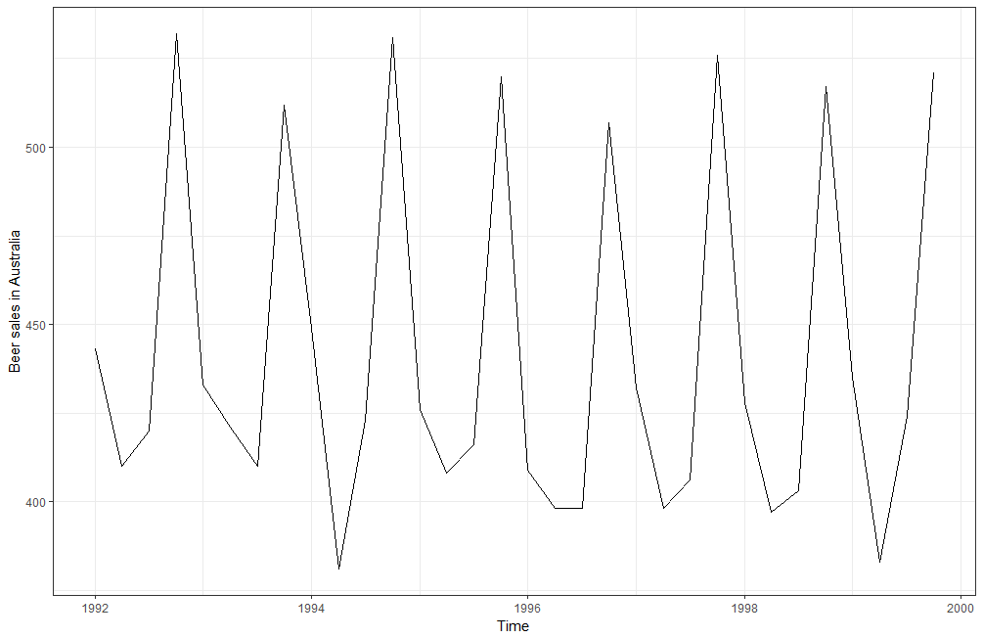
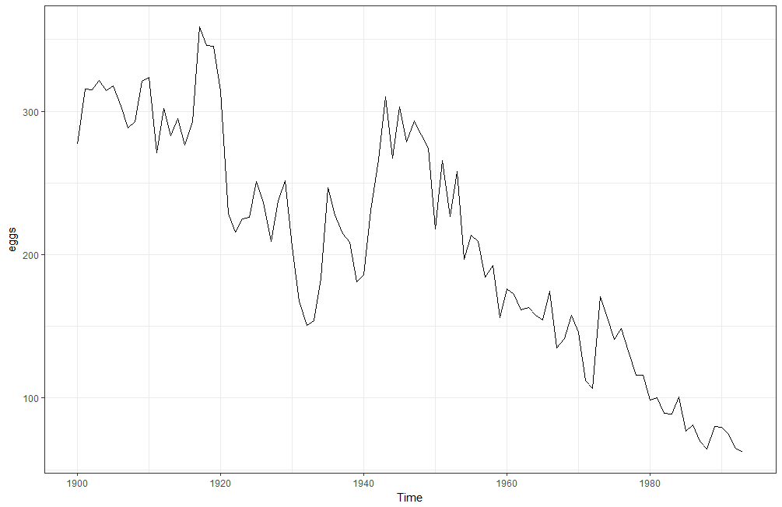
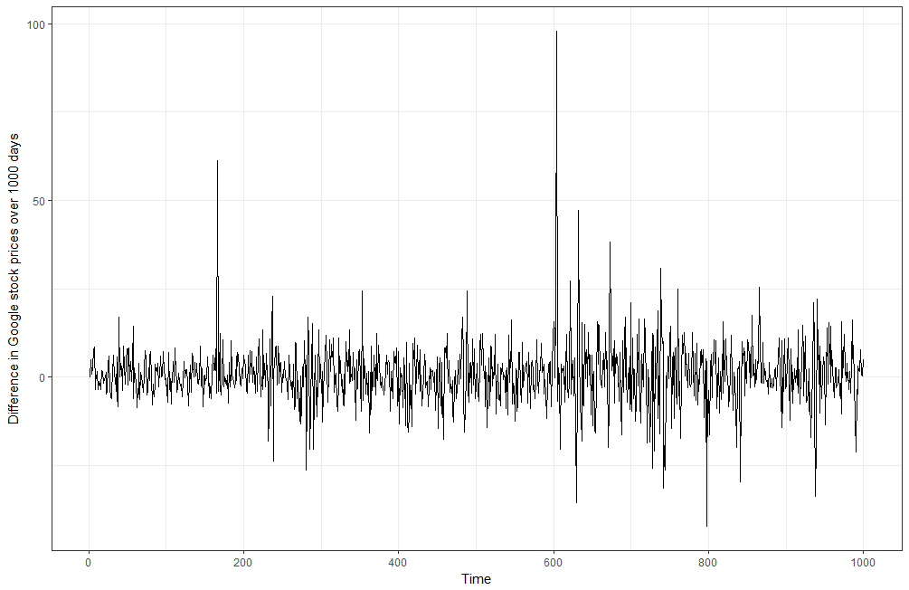
Stationarity

Slide 20
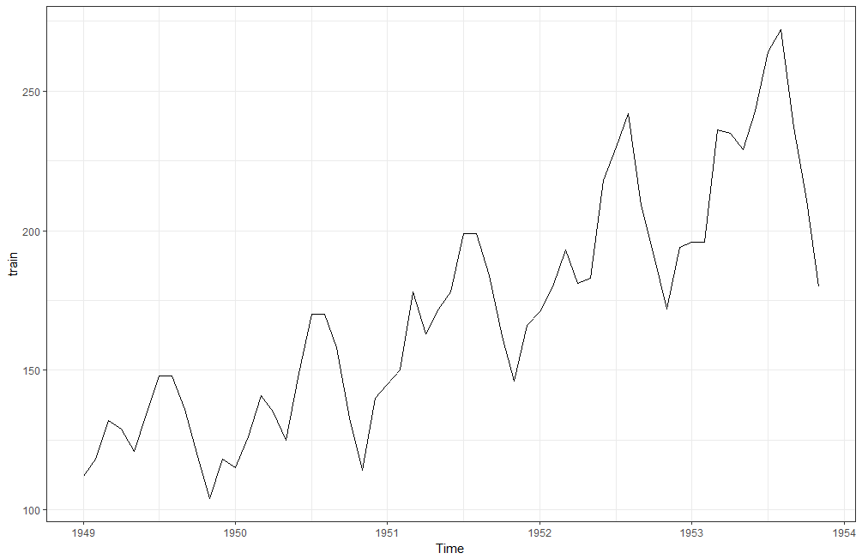
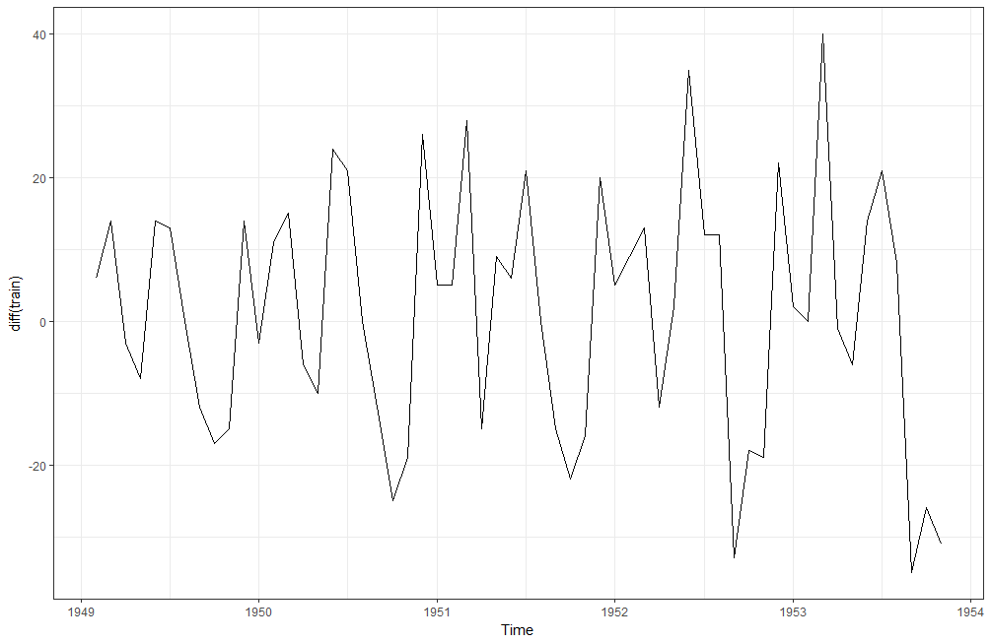
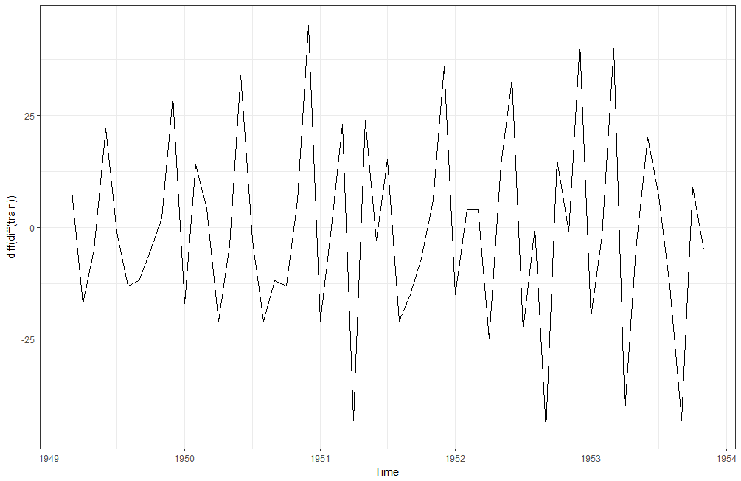
Differencing

Slide 21
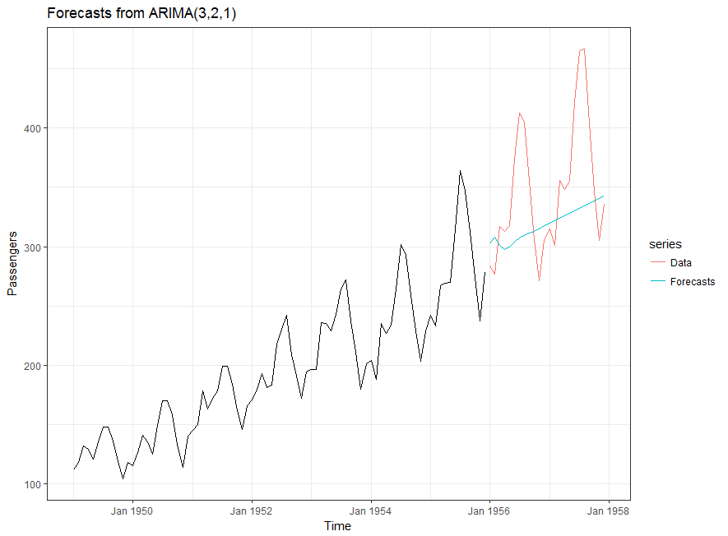
ARIMA(p,d,q)
ARMA(p,q) + differencing of order d
ARIMA(p,d,q)

Slide 22
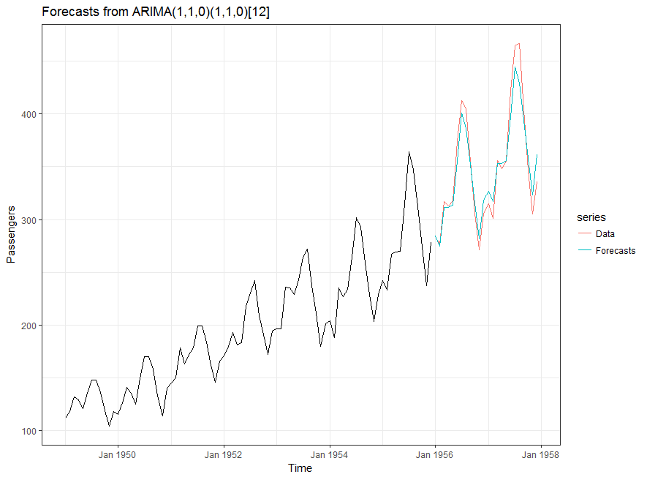

Seasonal ARIMA/SARIMA:
$ARIMA\left(p,q,d\right){\left(P,Q,D\right)}_{m}$

Slide 23
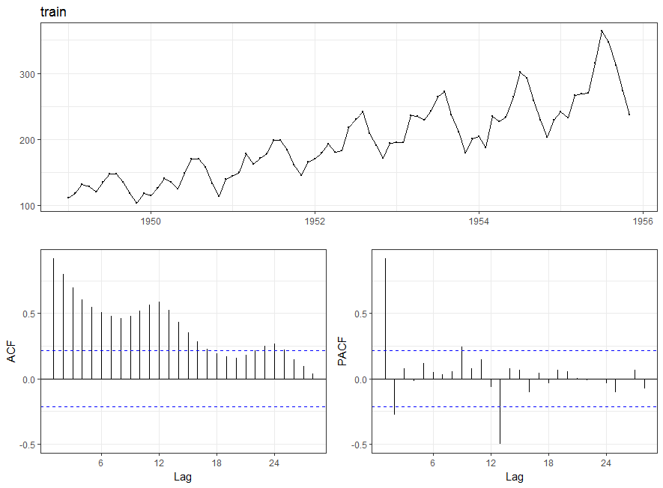
Choosing ARIMA orders:
Auto-Correlation Function
Partial Auto-Correlation Function

Slide 24
Bayesian time series models
Based on Bayes relationship
Calculate Prior Time Series model based on domain knowledge
Update Model as actuals come in

Slide 25
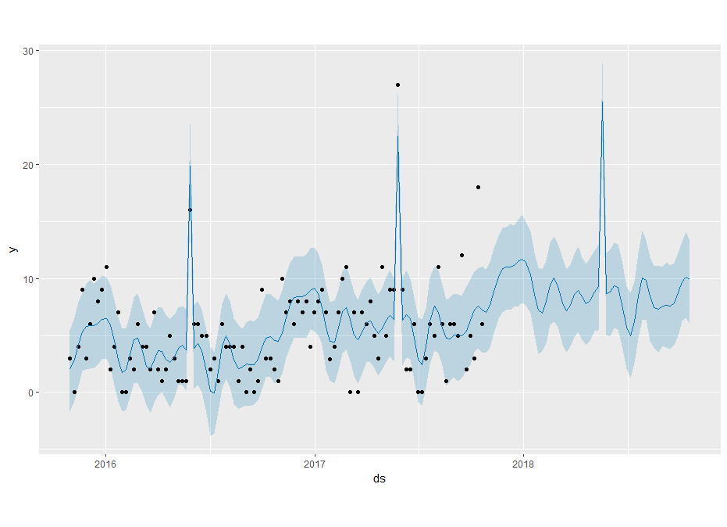
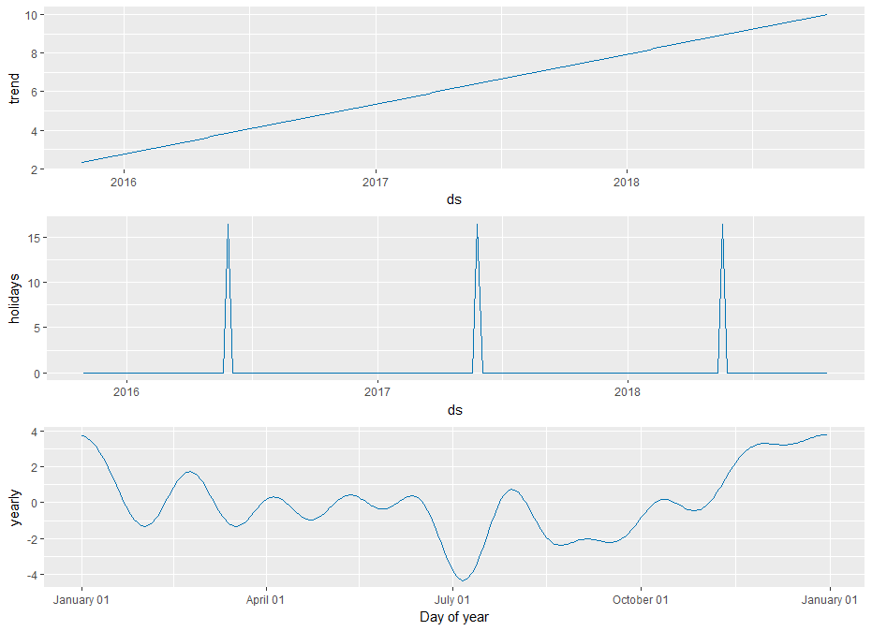
Generalized Additive Models
y(t) = g(t) + s(t) + h(t) + ε(t)

Slide 26
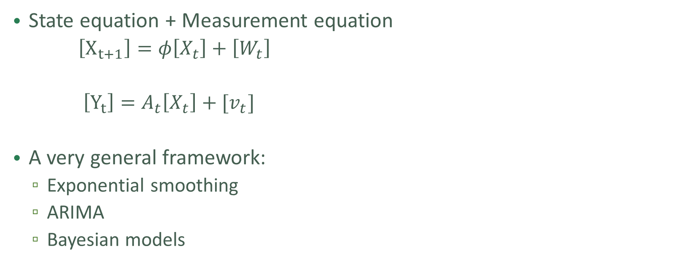
State Space models
State equation + Measurement equation
  $\left[X_{t+1}\right]=φ\left[X_{t}\right]+\left[W_{t}\right]$
  $\left[Y_{t}\right]=A_{t}\left[X_{t}\right]+[v_{t}]$
A very general framework:
  Exponential smoothing
  ARIMA
  Bayesian models

Slide 27
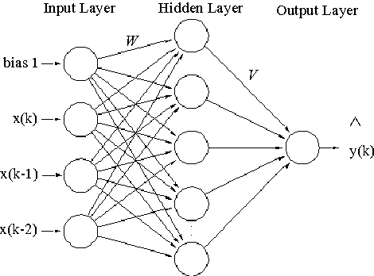
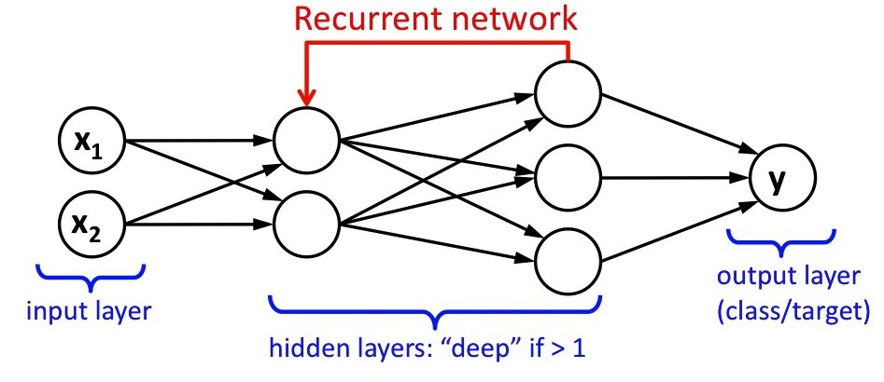
Neural Networks
Multi-Layer Perceptrons: Good – but don’t have any memory
Recurrent Neural Networks: Added feedback loop
  have some memory
  Tend to forget older data
Long-Short-Term-Memory: More complicated Neuron with multiple internal states:
  Can remember long term patterns

Slide 28
Other models
GARCH models:
VAR models
Hierarchical Forecasting
TBATS
Temporal Aggregation
Just about any supervised learning algorithm – SVM, RF, Boosted Trees,….

Slide 29
Software tools & packages
R packages:
  Forecast
S-Plus
Python Statsmodels
Tensorflow:
  Tf.contrib.timeseries
  AR models and State Space models
Facebook Prophet
  A variation on GAM
DeepAR (Amazon)
Autobox
SPSS
SAS

Slide 30
Further reading
Confidence intervals
Exogenous variables
Forecast Aggregation
Accuracy Measures
Spectral / Frequency domain analysis

Slide 31
Challenges of Fashion Retail Demand Forecasting
Millions of time series (~ 10K SKUs × 100 Stores) .
Short histories
Sparse time series
Data is highly seasonal
Data can be grouped in similar classes, departments, regions, ….

Slide 32
Questions?

